Slide 1

SELF-HEALING POLYMERS
Reneeka Nadkarni C034
Amishi Desai C044
Chahel Gupta C049

Slide 2
INTRODUCTION
GROWTH OF SHP
CLASSIFICATION
SYNTHESIS
IMPORTANCE
APPLICATION
FUTURE SCOPE
CONCLUSION
REFERENCES

Slide 3
INTRODUCTION

Slide 4
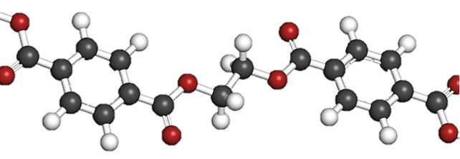
WHAT ARE POLYMERS?
Long repeating chains of molecules.
its properties depend on the type of molecules and the way they are bonding.
In artificial polymers; chain’s links are identical to its neighbors
In natural polymers, links in the chain differ from their neighbors.
WHAT ARE SELF-HEALING POLYMERS?
They are the new smart materials that have the capability to repair themselves when they are damaged without the need for detection or any manual repair.

Slide 5
HISTORY OF SELF-HEALING POLYMERS
This self healing process of materials started in the 1970s when space exploration came about (The Apollo mission). The shuttle was constructed of materials like ammonium perchlorate-filled hydroxyl-terminated polybutadiene. At first, it was assumed that the materials could be damaged but it was later clear that this damage could be self healing.
In the beginning of the 1980s, many different examples were studied intensively. Self healing polymers in microcapsules being a breakthrough in 2001.
These materials have received great attention due to the decrease in system breakdown, cost of maintenance, and increase in safety index.

Slide 6
GROWTH OF SHP

Slide 7
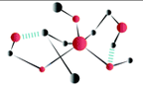

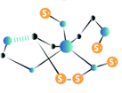

2nd Generation
3rd Generation
1st Generation
4th Generation

Slide 8
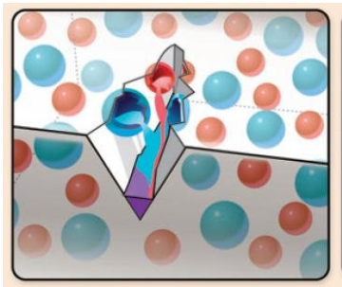
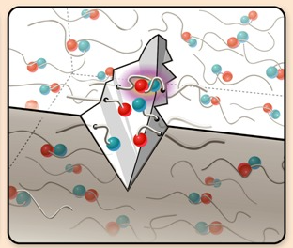
1
Also known as capsule based generation
Employs the encapsulation of external healing agents
Based on extrinsic mechanisms
Based on intrinsic mechanisms
Based on chemistry of dynamic bonds and reversible bonds.
The intrinsic approach has been studied in all kinds of polymers, with special emphasis in the field of elastomers.
2

Slide 9
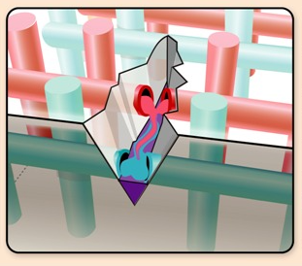
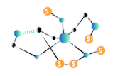
Known as Vascular- Based generation
Inspired by natural examples
Extensively studied in thermosets, but their application in elastomers remains limited except for a few reports on silicones.
Classified according to the nature of the vascular network and its preparation technique
3
Growing fast to overcome the different drawbacks of the previous 3 generations
Objective is to develop a polymer with excellent mechanical properties, and high healing efficiency and resistance to multiple damage cycles through the combination of different healing mechanisms
4

Slide 10
CLASSIFICATION

Slide 11
TYPES OF SELF HEALING
Intrinsic self-healing
Where the polymers themselves heal molecular and macroscopic damage.
Extrinsic self-healing
Where a healing agent is pre-embedded in the polymer matrix.
(1) Autonomic healing: Fully self-contained and requiring no external intervention of any kind.
(2) Non-autonomic healing: Partially self-contained; healing capability is designed into the material, but additional external stimuli such as heat or UV-radiation is required for the healing to occur.

Slide 12
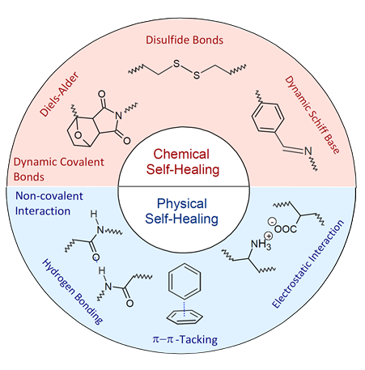
INTRINSIC SELF HEALING
The two main categories are physical interaction and chemical bonding.
Functionality designed or added to material but is not a discrete phase within the bulk material matrix
Mobility to initiate healing response begins with absorption of energy provided by external stimuli.
Most chemical healing methods are non-autonomic.

Slide 13
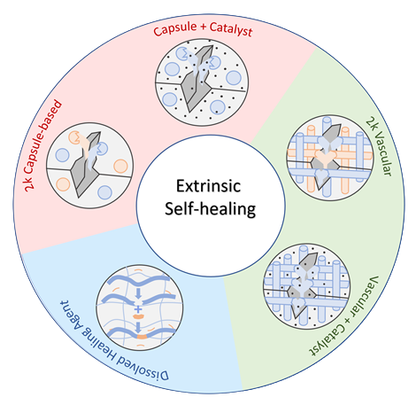
EXTRINSIC SELF HEALING
Functionality added to the coating as a separate compartmentalized healing agent within the bulk matrix
Mobility to initiate a healing response comes from release of healing agent from compartments.
The depletion of the healing agent in microcapsules leads to only a singular healing event.
However, interconnected microvascular composites allow for multiple healing events.

Slide 14
SYNTHESIS

Slide 15
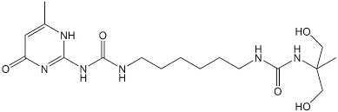
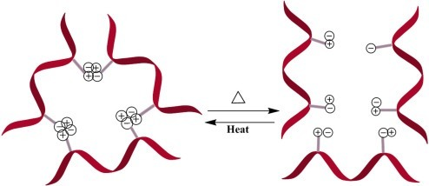
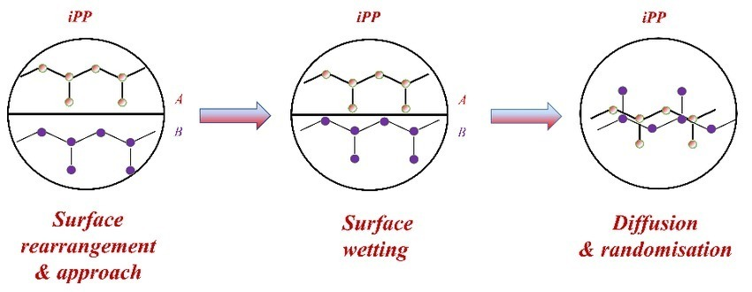
INTRINSIC PHYSICAL SELF-HEALING
Based on non-covalent interactions including π-π stacking, diffusion and entanglement, ionic and hydrophobic interactions, hydrogen bonding, and metal coordination.
Ionomeric self-healing systems
Supramolecular self-healing
Self-healing via molecular diffusion & entanglement
Consist of thermoplastic ionic copolymers
Made up of hydrocarbon chains, a portion being carboxylic groups
Neutralized with metal or quaternary ammonium ions [poly(ethylene-co-methacrylic acid)
EMAA clusters act as reversible cross-links
External stimuli like temperature & UV light
Made up of polymers with strong end-group and/or side-group associations via hydrogen bonding
Can be fractured and mended
Allow for reformation of the hydrogen bonds
Healing of damaged areas induced by temperature/pressure.
Temperature/pressure should be high enough to allow diffusion and entanglement
Can heal damages in styrene-isoprene-styrene block copolymers, polystyrene and thermoplastics.

Slide 16
INTRINSIC CHEMICAL SELF-HEALING
Can be only applied to soft thermoplastic materials (hydrogels) or thermoplastic/thermosetting semi-interpenetrating polymer networks that have mobile soft and immobile rigid domains.
Based on reversible covalent bonding.
Requires an external stimulus such as heat or UV radiation to break and reform bonds.
Provides higher mechanical strength and greater dimensional stability
Widely utilized reversible reaction is the cycloaddition of a diene to a dienophile known as Diels-Alder (DA), whereas the reverse reaction is called retro-Diels-Alder (rDA).
A portion of the bonds are replaced with DA bonds.
They are broken and reformed when heated allowing the chains to flow into cracks and form new bonds
This chemistry is used to develop numerous thermally-induced, self-healable polymers.
Other common dynamic bonds utilized include disulfide bridges, trithiocarbonates, acylhydrazone bonds, urea linkages with bulky substituents, boronic esters, alkoxyamines etc

Slide 17
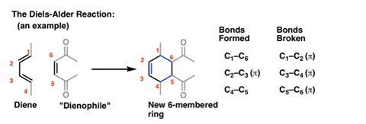

Slide 18
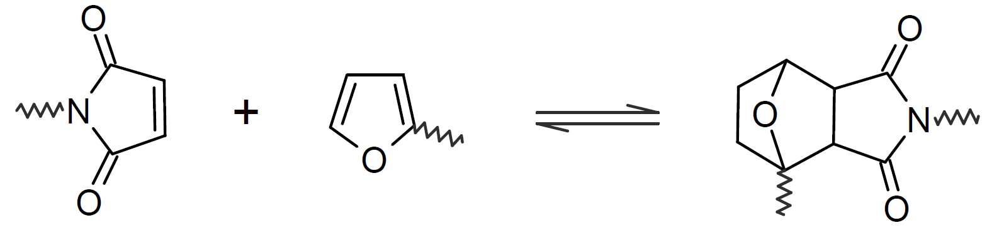
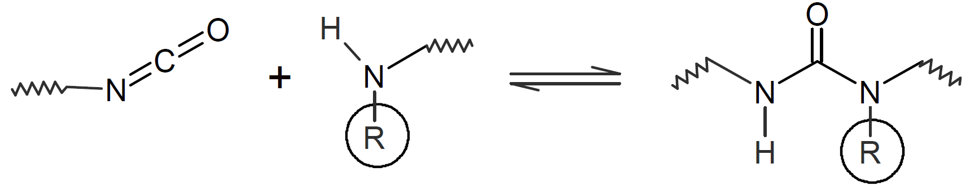
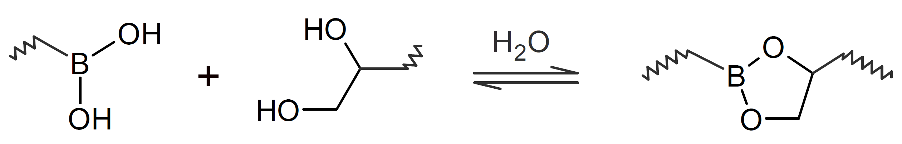
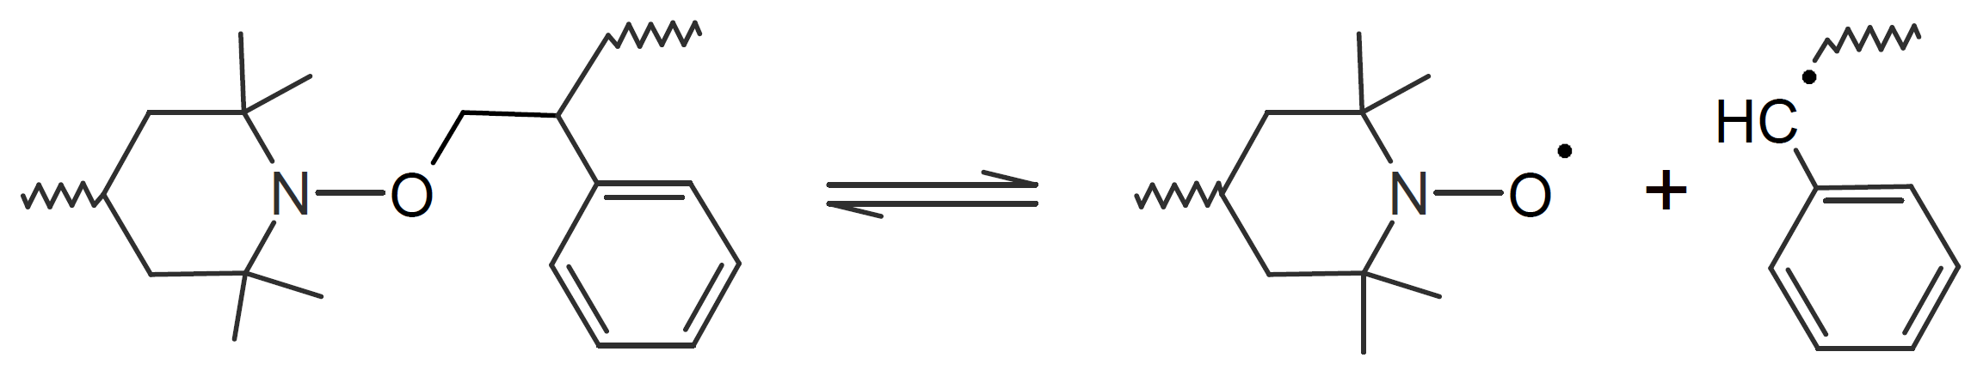
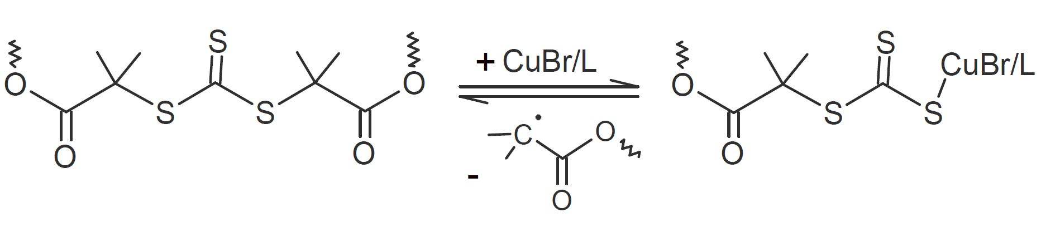
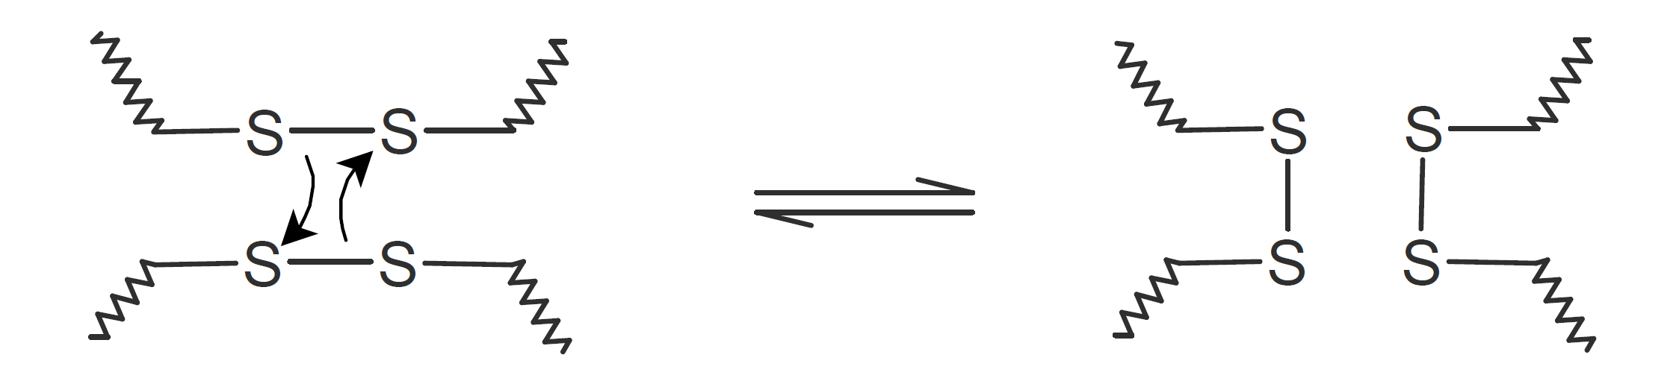
REVERSIBLE DYNAMIC LINKAGES
Bond Type | Reversible Reaction
Diels-Alder
Hindered Urea
Boronic Ester
Alkoxy Amine
Trithiocarbonate
Disulphides

Slide 19
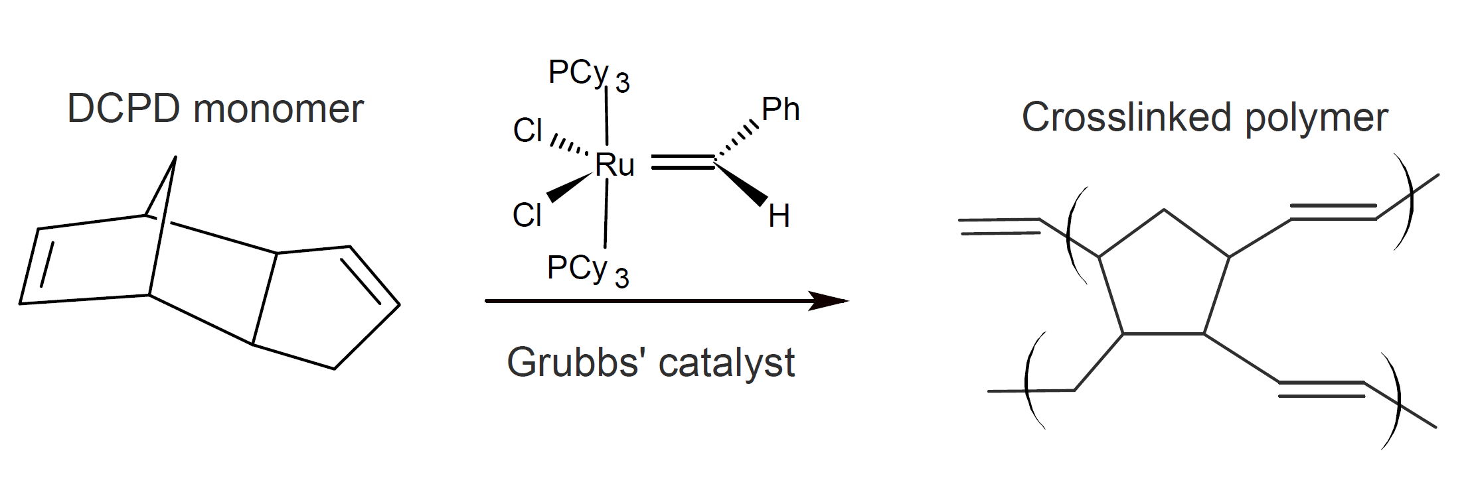
EXTRINSIC SELF-HEALING
ENCAPSULATION OF A HEALING AGENT
This extrinsic self-healing system is based on a 3-dimensional network of capillaries or hollow fibers incorporated into a polymer matrix.
Due to this interconnected microvascular structure, the healing agent in the hollow fibers flows to the depleted areas
This allows multiple healing events.
These Epoxy-based systems require encapsulation of a healing agent.
A healing agent frequently employed is dicyclopentadiene (DCPD) undergoes a ring-opening metathesis polymerization (ROMP) in the presence of a transition metal catalyst such as ruthenium-based Grubbs catalyst.
Capsules filled with DCPD are typically prepared by micro encapsulation techniques using a urea-formaldehyde shell, whereas the corresponding catalyst is dispersed in the epoxy resin matrix.

Slide 20
IMPORTANCE

Slide 21
Provides early means of detection of damage.
In Self-healing materials, it is possible to restore the performance without affecting the inherent properties.
Prolonging the service life of materials.
Provide continuous healing over lifetime.
80-90% recovery of mechanical strength.
Integrate the material surface without any ridges.
Requires less infrastructural maintenance.
Helps in building sustainable society.

Slide 22
BASED ON CHEMISTRY
Resistance to Solvents
Tensile Strength
Stiffness
Elastic
Tough

Slide 23
APPLICATIONS

Slide 24



Construction
Medicine
Electronic
Textile
Paints and Coatings
Aviation/Aerospace

Slide 25
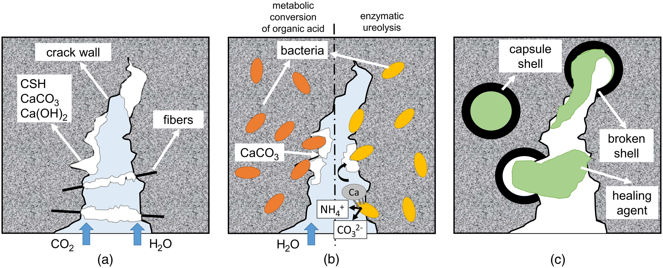
CONSTRUCTION
Autogenous healing
Bio-based healing
Chemical additives based healing

Slide 26
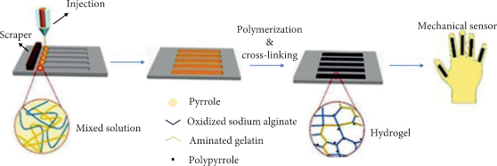
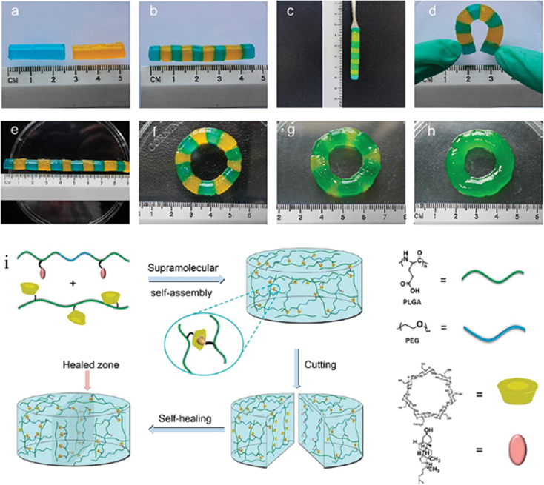
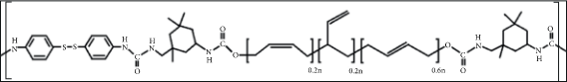
ELECTRONICS
Formation of Double-network hydrogel
polybutadiene-based poly(urea-urethane) (PBPUU)
Double-network hydrogel

Slide 27
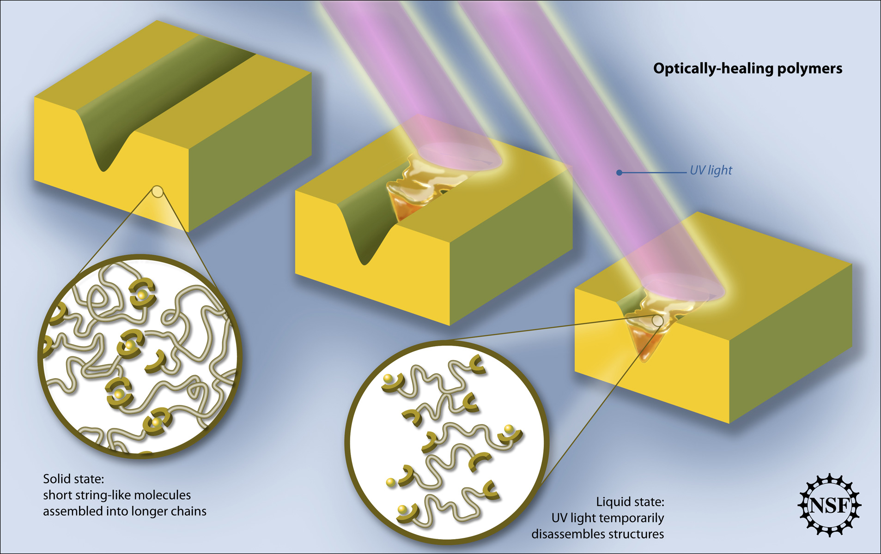
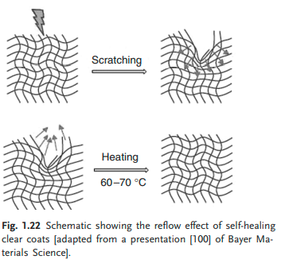
PAINTS AND COATINGS

Slide 28
FUTURE SCOPE

Slide 29

TERZOMILLENIO

Slide 30
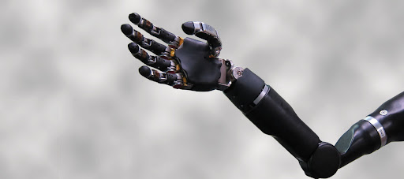
SELF HEALING HUMAN PROSTHETICS

Slide 31
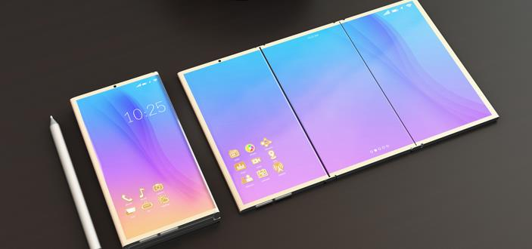
FOLDING iDEVICE

Slide 32
CONCLUSION
Considering the long-term stability and self-heal ability, SHPs are the best composite material among the next-generation materials. This material can be used in many diverse environments with higher stability comparing conventional material. Therefore, using this composite material would be economic in industrial sectors. The progress of SHPs day by day makes this type of material worth using in every sector. The special features of newly developed SHPs reveal a new way to produce and apply advanced materials. Now, these new types of material enable us to produce various products with a longer lifetime and stability.

Slide 33
REFERENCES
https://www.sciencenewsforstudents.org/article/explainer-what-are-polymers
https://www.livescience.com/60682-polymers.html
https://www.sciencedirect.com/topics/materials-science/self-healing-polymer
https://www.researchgate.net/publication/228525532_Self-healing_materials_A_review
https://www.researchgate.net/publication/230866144_An_experimental_study_of_the_self-healing_behavior_of_ionomeric_systems_under_ballistic_impact_tests
https://www.mdpi.com/2073-4360/12/7/1534/htm
https://www.google.com/url?sa=t&rct=j&q=&esrc=s&source=web&cd=&cad=rja&uact=8&ved=2ahUKEwivq5P44cbzAhVbb30KHX4GA-kQFnoECAcQAQ&url=https%3A%2F%2Fwww.mdpi.com%2F2226-4310%2F6%2F2%2F14%2Fpdf&usg=AOvVaw1bgpCNVOleepzGVlYnlYMT
https://polymerdatabase.com/polymer%20chemistry/Self-healing%20Polymers2.html
https://polymerdatabase.com/polymer%20chemistry/Self-healing%20Polymers.html
https://www.jstor.org/stable/23019350
https://in.askmen.com/cars/1118531/article/a-self-healing-car-we-kid-not-its-called-the-lamborghini-terzo-millennio
Polymers | Free Full-Text | Self-Healing Mechanisms for 3D-Printed Polymeric Structures: From Lab to Reality | HTML (mdpi.com)
http://whitegroup.beckman.illinois.edu/journal%20articles/nrs098.pdf
https://onlinelibrary.wiley.com/doi/full/10.1002/aenm.201700890
https://www.hindawi.com/journals/apt/2021/7848088/
https://pubs.rsc.org/en/content/articlelanding/2020/mh/d0mh00535e

Slide 34
https://www.sciencedirect.com/topics/materials-science/self-healing-polymer
https://www.hindawi.com/journals/apt/2021/7848088/
https://application.wiley-vch.de/books/sample/3527318291_c01.pdf
http://www.research.bayer.com/ edition 16/Self healing automotive coating.aspx. (Access year 2008).
http://www.nissan-global.com/EN/ TECHNOLOGY/INTRODUCTION/ DETAILS/SGC/index.html. (Access year 2008)
https://www.sciencedirect.com/science/article/pii/S007967001300097X
https://www.researchgate.net/publication/324604179_Self -Healing_Electronic_Materials_for_a_Smart_and_Sustainable_Future/link/5bb409c7299bf13e605cec30/download
https://www.frontiersin.org/articles/10.3389/fchem.2018.00449/full
https://reader.elsevier.com/reader/sd/pii/S0014305714000366?token=C354EF49A0654D6FE15DEA92FACB2E65086ADAD3176C902179BBB0714802CC1AB54D9538CB1B32AB88272E8A09A169D1&originRegion=eu-west-1&originCreation=20211010185751
https://www.sciencedirect.com/science/article/pii/S0014305714000366
https://www.intechopen.com/chapters/51518
https://www.pcimag.com/articles/108305-leveraging-self-healing-polymer-technology-in-coating-design
https://edu.rsc.org/feature/the-chemistry-of-self-healing-polymers/2020246.article
https://www.slideshare.net/BasitaliNevarekar1/20150415-100402332
https://onlinelibrary.wiley.com/doi/pdf/10.1002/0471440264.pst469
https://www.sciencedirect.com/science/article/pii/S2352507X20300470
https://application.wiley-vch.de/books/sample/3527318291_c01.pdf
https://www.pcimag.com/articles/108305-leveraging-self-healing-polymer-technology-in-coating-design
https://www.researchgate.net/publication/324604179_Self-Healing_Electronic_Materials_for_a_Smart_and_Sustainable_Future/link/5bb409c7299bf13e605cec30/download

Slide 35
Thank You!

